Slide 1
Azure - Day 3 Epam DevOps School
Networks
Azure PaaS
CONFIDENTIAL | © 2020 EPAM Systems, Inc.

Slide 2
AZ-103T00A Module 04: Virtual Networking

Slide 3
Module Overview
Virtual Networks
IP Addressing and Endpoints
Azure DNS
Network Security Groups
Lab and Review Questions
Notes:
Module overview

Slide 4
Lesson 01: Virtual Networks

Slide 5
Virtual Networks Overview
Azure Networking Components
Virtual Networks
Subnets
Implementing Virtual Networks
Demonstration – Creating Virtual Networks
Multiple NICs in Virtual Machines
Demonstration – Create VMs with Multiple NICs
Notes:
Lesson overview

Slide 6
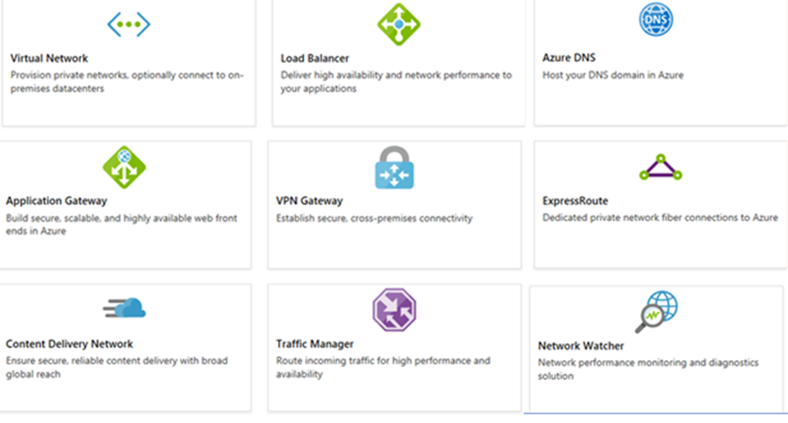
Azure Networking Components
Adopting cloud solutions can save time and simplify operations
Azure requires the same types of networking functionality as on-premises infrastructure
Azure networking offers a wide range of services and products
Notes:
For more information, you can see:
Azure Virtual Networks - https://azure.microsoft.com/en-us/services/virtual-network/

Slide 7
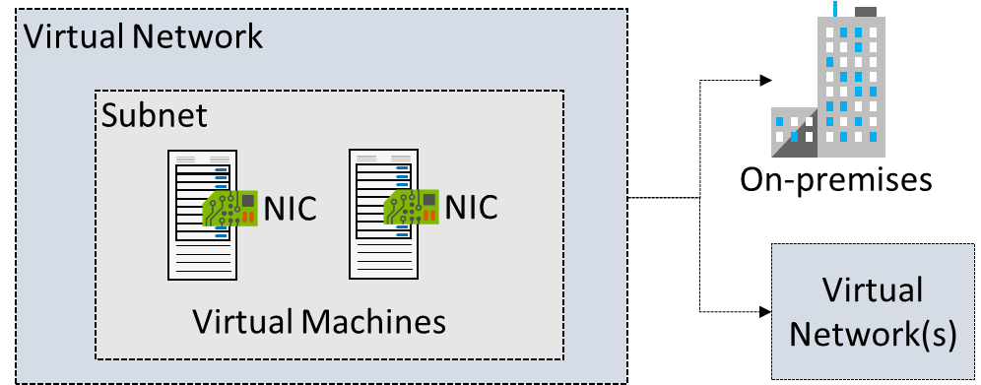
Virtual Networks
Logical representation of your own network
Create a dedicated private cloud-only VNet
Securely extend your datacenter With VNets
Enable hybrid cloud scenarios

Slide 8
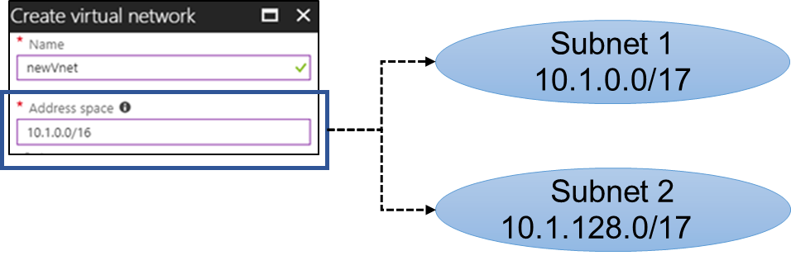
Subnets
A virtual network can be segmented into one or more subnets
Subnets provide logical divisions within your network
Subnets can help improve security, increase performance, and make it easier to manage the network
Each subnet must have a unique address range - cannot overlap with other subnets in the virtual network in the subscription
Notes:
✔️ Azure reserves the first three IP addresses and the last IP address in each subnet address range.

Slide 9
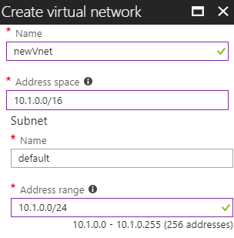
Implementing Virtual Networks
Create new virtual networks at any time
Add virtual networks when you create a virtual machine
Need to define the address space, and at least one subnet
Be careful with overlapping address spaces
Notes:
✔️ Always plan to use an address space that is not already in use in your organization, either on-premises or in other VNets. Even if you plan for a VNet to be cloud-only, you may want to make a VPN connection to it later. If there is any overlap in address spaces at that point, you will have to reconfigure or recreate the VNet. The next lesson will focus on IP addressing.

Slide 10
Demonstration – Creating Virtual Networks
Create a virtual network in the portal
Create a virtual network with PowerShell

Slide 11
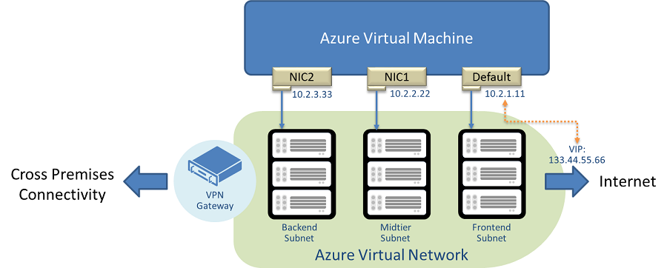
Multiple NICs in Virtual Machines
You can create virtual machines with multiple NICs
Useful for virtual appliances, network traffic management, and isolation of traffic
The VM size determines the number of NICs that can be supported

Slide 12
Demonstration – Create VMs with Multiple NICs (CLI)
Create a VNet, subnet, and NSG
Create and configure multiple NICs
Create a VM and attach the NICs
Notes:
✔ Always consider having students walk-through the demonstrations themselves. Also, consider the overlap with the formal labs and your best use of time.

Slide 13
Lesson 02: IP Addressing and Endpoints

Slide 14
IP Addressing Overview
IP Addressing
Public IP Addresses
Private IP Addresses
Demonstration – Manage IP Addresses
Service Endpoints
Service Endpoint Services
Secure Access to Storage
Demonstration – Service Endpoints
Notes:
Lesson overview

Slide 15
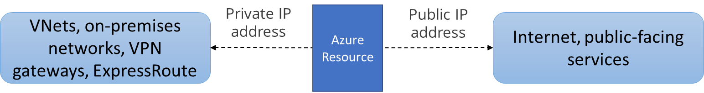
IP Addressing
Private IP addresses are used within an Azure virtual network (VNet), and your on-premises network, when you use a VPN gateway or ExpressRoute circuit to extend your network to Azure
Public IP addresses is used for communication with the Internet, including Azure public-facing services
Notes:
✔️ As a best practice you may decide to separate dynamically and statically assigned IP resources into different subnets. And, IP Addresses are never managed from within a virtual machine.

Slide 16
Public IP Addresses
Public IP addresses | IP address association | Dynamic | Static
Virtual Machine | NIC | Yes | Yes
Load Balancer | Front-end configuration | Yes | Yes
VPN Gateway | Gateway IP configuration | Yes | No
Application Gateway | Front-end configuration | Yes | No
A public IP address resource can be associated with virtual machine network interfaces, internet-facing load balancers, VPN gateways, and application gateways.

Slide 17
Private IP Addresses
Private IP Addresses | IP address association | Dynamic | Static
Virtual Machine | NIC | Yes | Yes
Internal Load Balancer | Front-end configuration | Yes | Yes
Application Gateway | Front-end configuration | Yes | Yes
Dynamic (default). Azure assigns the next available unassigned or unreserved IP address in the subnet's address range
Static. You select and assign any unassigned or unreserved IP address in the subnet's address range

Slide 18
Demonstration - Manage IP Addresses
Retrieve static private IP address information
Remove a static private IP address
Notes:
✔ Always consider having students walk-through the demonstrations themselves. Also, consider the overlap with the formal labs and your best use of time.

Slide 19
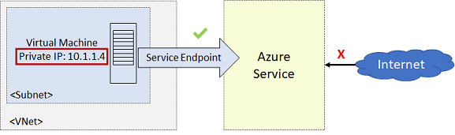
Service Endpoints
Endpoints limit network access to specific subnets and IP addresses
Improved security for your Azure service resources
Optimal routing for Azure service traffic from your virtual network
Endpoints use the Microsoft Azure backbone network
Simple to set up with less management overhead
Notes:
✔️ Can you see a use for service endpoints in your organization?
For more information, you can see:
Virtual network service endpoints - https://docs.microsoft.com/en-us/azure/virtual-network/virtual-network-service-endpoints-overview

Slide 20
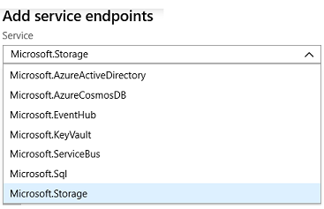
Service Endpoint Services
✔️ Adding service endpoints can take up to 15 minutes to complete

Slide 21
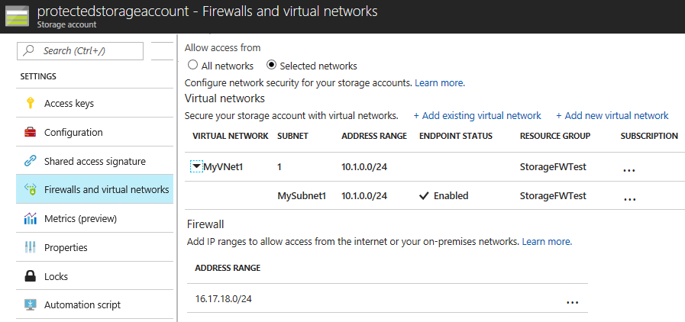
Secure Access to Storage Endpoints
Must configure both sides of the endpoints. For example, the virtual network side and the storage account side.
Each service endpoint has its own Azure documentation page
Notes:
✔️It is important to test and ensure the service endpoint is limiting access as expected. You will do this in the practice exercise.

Slide 22
Demonstration – Service Endpoints
Create a storage account
Create a subnet service endpoint
Secure the storage to the service endpoint
Test the storage endpoint

Slide 23
Lesson 03: Azure DNS

Slide 24
Azure DNS Overview
Domains and Custom Domains
Verifying Custom Domain Names
Azure DNS Zones
DNS Record Sets
DNS Delegation
DNS for Private Domains
Private Zones Scenarios
Demonstration – DNS Name Resolution
Notes:
Lesson overview

Slide 25
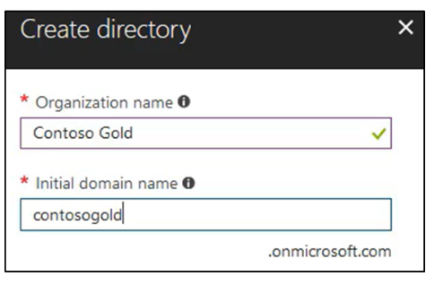
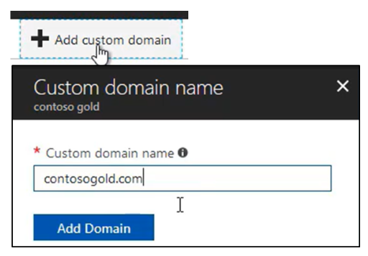
Domains and Custom Domains
When you create an Azure subscription an Azure AD domain is created for you
The domain has initial domain name in the form domainname.onmicrosoft.com
You can customize/change the name
After the custom name is added it must be verified (next topic)

Slide 26
Verify the Custom Domain Name
Verification demonstrates ownership of the domain name
Add a DNS record (MX or TXT) that is provided by Azure into your company’s DNS zone
Azure will query the DNS domain for the presence of the record
This could take several minutes or several hours

Slide 27
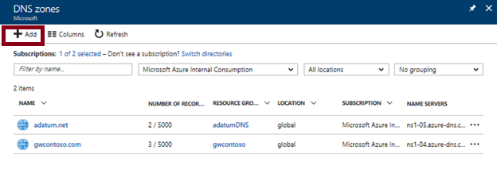
Azure DNS Zones
A DNS zone hosts the DNS records for a domain
The name of the zone must be unique within the resource group
Where multiple zones share the same name, each instance is assigned different name server addresses
Only one set of addresses can be configured with the domain name registrar
Notes:
✔️ You do not have to own a domain name to create a DNS zone with that domain name in Azure DNS. However, you do need to own the domain to configure the domain.
For more information, you can see:
DNS Zones - https://docs.microsoft.com/en-us/azure/dns/dns-zones-records#dns-zones

Slide 28
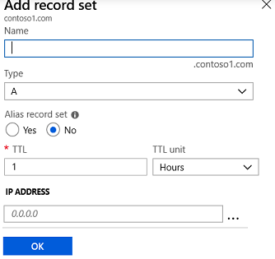
DNS Record Sets
A record set is a collection of records in a zone that have the same name and are the same type
You can add up to 20 records to any record set
A record set cannot contain two identical records
Changing the drop-down Type, changes the information required

Slide 29
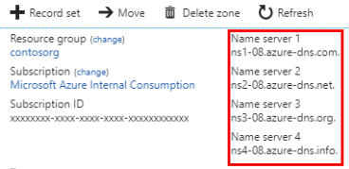
DNS Delegation
When delegating a domain to Azure DNS, you must use the name server names provided by Azure DNS – use all four
Once the DNS zone is created, update the parent registrar
For child zones, register the NS records in the parent domain
Notes:
The PowerShell slide is coming up.

Slide 30
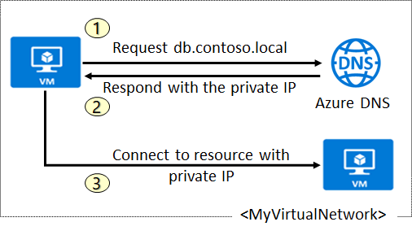
DNS for Private Domains
Use your own custom domain names
Provides name resolution for VMs within a VNet and between VNets
Automatic hostname record management
Removes the need for custom DNS solutions
Use all common DNS records types
Available in all Azure regions

Slide 31
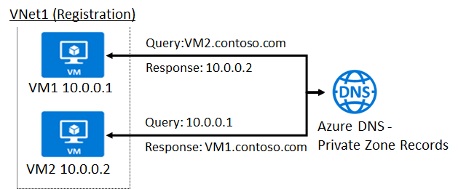
Private Zone Scenarios
VNet2
Resolution
DNS resolution in VNet1 is private and not accessible from the Internet
DNS queries across the virtual networks are resolved
Reverse DNS queries are scoped to the same virtual network

Slide 32
Demonstration – DNS Name Resolution
Create a DNS zone
Add a DNS record set
Use PowerShell to view DNS information
View your name servers
Test the resolution
Explore DNS metrics
Notes:
✔ Always consider having students walk-through the demonstrations themselves. Also, consider the overlap with the formal labs and your best use of time.

Slide 33
Lesson 04: Network Security Groups (NSGs)

Slide 34
Network Security Groups Overview
Network Security Groups
NSG Rules
NSG Effective Rules
Creating NSG Rules
Demonstration - NSGs
Notes:
Lesson overview

Slide 35
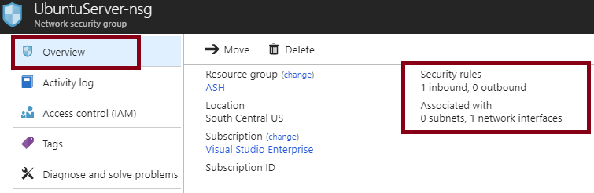
Network Security Groups (NSG)
You can limit network traffic to resources in a virtual network using a NSG
A NSG contains a list of security rules that allow or deny inbound or outbound network traffic
An NSG can be associated to a subnet or a network interface
Notes:
✔️ To simplify management of security rules, it's recommended that you associate a network security group to individual subnets, rather than individual network interfaces within the subnet.
For more information, you can see:
Network Security Groups - https://docs.microsoft.com/en-us/azure/virtual-network/security-overview#network-security-groups

Slide 36
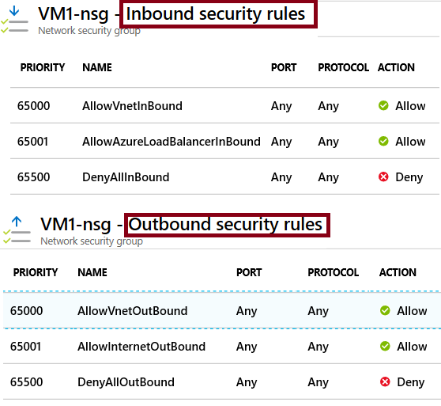
NSG Rules
Security rules in NSGs enable you to filter network traffic that can flow in and out of virtual network subnets and network interfaces.
There are default security rules. You cannot delete the default rules, but you can add other rules with a higher priority.

Slide 37
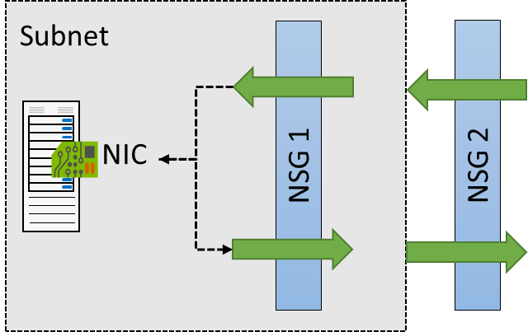

NSG Effective Rules
NSGs are evaluated independently for the subnet and NIC
An “allow” rule must exist at both levels for traffic to be admitted
Use the Effective Rules link if you are not sure which security rules are being applied

Slide 38
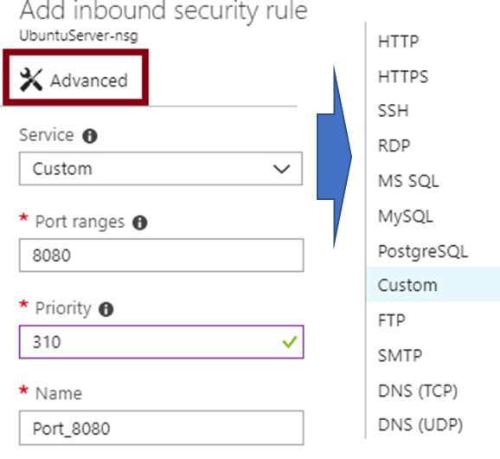
Creating NSG Rules
Select from a large variety of services
Service - The destination protocol and port range for this rule
Port ranges – Single port or multiple ports
Priority - The lower the number, the higher the priority

Slide 39
Demonstration – Network Security Rules
Access the NSGs blade
Add a new NSGs
Explore inbound and outbound rules
Notes:
✔ Always consider having students walk-through the demonstrations themselves. Also, consider the overlap with the formal labs and your best use of time.

Slide 40
Lesson 05: Lab and Review Questions

Slide 41
Lab – Configure Azure DNS
Adatum Corporation wants to implement public and private DNS service in Azure without having to deploy its own DNS servers.
Exercise 1. Configure Azure DNS for public domains
Exercise 2. Configure Azure DNS for private domains
Lab time: 60 minutes

Slide 42
Module Review Questions
Notes:
As you have time go through the Module Review questions in the student materials.

Slide 43
AZ-103T00A Module 05: Intersite Connectivity
Notes:
The VNet Peering and Service Chaining lab for this module has setup time. If you are going to do the lab, consider completing Exercise 0: Prepare the lab environment before starting the lecture.

Slide 44
Module Overview
VNet Peering
VNet-to-VNet Connections
ExpressRoute
Lab and Review Questions
Notes:
Module overview

Slide 45
Lesson 01: VNet Peering

Slide 46
VNet Peering Overview
VNet Peering
Gateway Transit and Connectivity
Configure VNet Peering
Service Chaining
Demonstration – VNet Peering
Notes:
Lesson overview

Slide 47
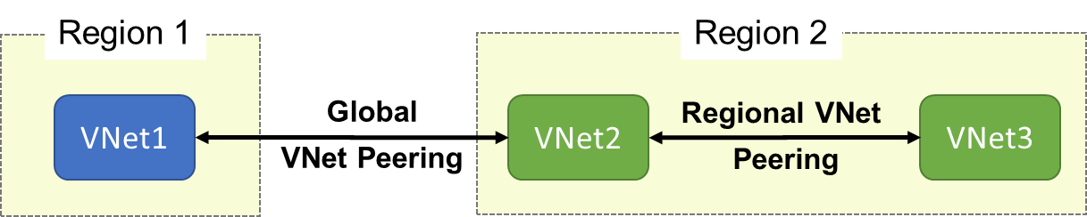
VNet Peering
VNet peering connects two Azure virtual networks
Two types of peering: Regional and Global
Peered networks use the Azure backbone for privacy and isolation
Easy to setup, seamless data transfer, and great performance
Global peering has special requirements
Notes:
For more information, you can see:
Virtual network peering - https://docs.microsoft.com/en-us/azure/virtual-network/virtual-network-peering-overview

Slide 48
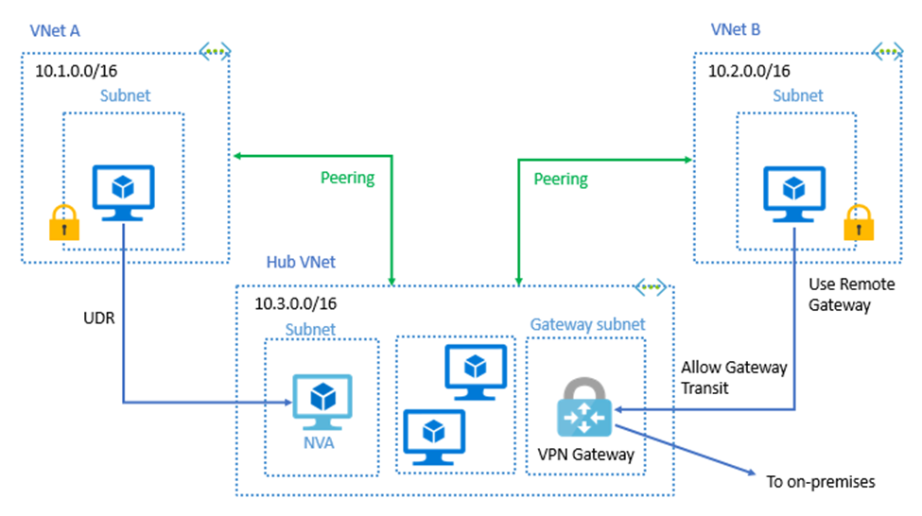
Gateway Transit and Connectivity
Gateway transit allows peered virtual networks to share the gateway and get access to resources
No VPN gateway is required in the peered virtual network
Default VNet peering provides full connectivity
Notes:
✔️ The default VNet peering configuration provides full connectivity. Network security groups can be applied in either virtual network to block access to other virtual networks or subnets, if desired. When configuring virtual network peering, you can either open or close the network security group rules between the virtual networks.

Slide 49
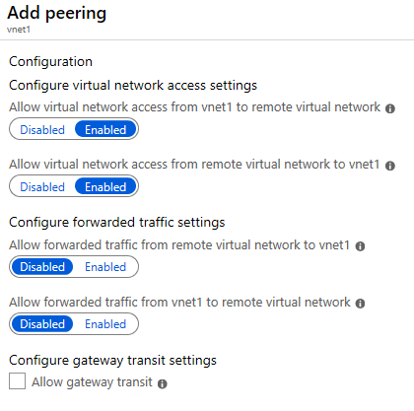
Configure VNet Peering
Allow forwarded traffic - from within the peer virtual network into your virtual network
Allow gateway transit - Allows the peer virtual network to use your virtual network gateway
Use remote gateways -only one virtual network can have this enabled
Notes:
✔️ When you add a peering on one virtual network, the second virtual network configuration is automatically added.
✔️ If you select ‘Allow gateway transit’ on one virtual network; then you should select ‘Use remote gateways’ on the other virtual network.

Slide 50
Demonstration – VNet Peering
Configure VNet peering on the first virtual network
Configure a VPN gateway
Allow gateway transit
Confirm VNet peering on the second virtual network

Slide 51
Lesson 02: VNet-to-VNet Connections

Slide 52
VNet-to-VNet Connections Overview
VNet-to-VNet Connections
Implement VNet-to-VNet Connections
Create a Gateway Subnet
Create the VPN Gateway
VPN Types
Gateway SKUs
Create the Local Network Gateway
Configure the On-Premises VPN Device
Create the VPN Connection
Verify the VPN Connection
Demonstration – VNet-to-VNet Connections
Notes:
Lesson overview

Slide 53
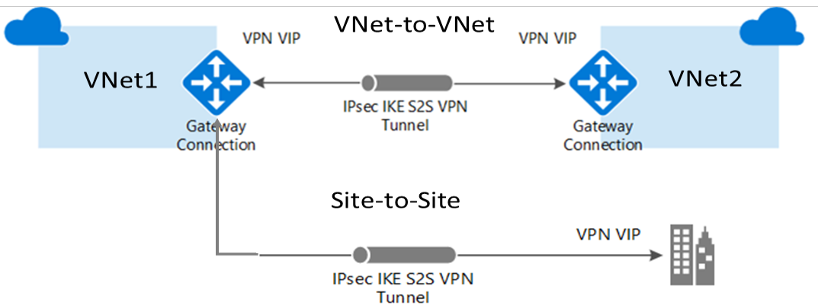
VNet-to-VNet Connections
Connect VNets with a VNet-to-VNet VPN connection
Requires a VPN gateway in each virtual network
A secure IPsec/IKE tunnel provides the communication
Use when VNet peering is not an option
Notes:
For more information, you can see:
VNet-to-VNet Connectivity - https://docs.microsoft.com/en-us/azure/vpn-gateway/vpn-gateway-howto-vnet-vnet-resource-manager-portal#vnet-to-vnet
Site-to-Site ( IPsec) - https://docs.microsoft.com/en-us/azure/vpn-gateway/vpn-gateway-howto-site-to-site-resource-manager-portal

Slide 54
Implement VNet-to-VNet Connections
Azure
On-premises
Azure
Create VNets and Subnets
Specify the DNS Server (optional)
Create the Gateway Subnet
Create the VPN Gateway
Create the Local Network Gateway
Configure the VPN Device
Create the VPN Connection
Take time to carefully plan your network configuration
The on-premises part is necessary only if you are configuring Site-to-Site
Always verify and test your connections

Slide 55
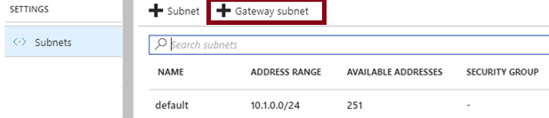
Create the Gateway Subnet
The gateway subnet contains the IP addresses; if possible, use a CIDR block of /28 or /27.
When you create your gateway subnet, gateway VMs are deployed to the gateway subnet and configured with the required VPN gateway settings.
Never deploy other resources (for example, additional VMs) to the gateway subnet.
Avoid associating a NSG with the gateway subnet.

Slide 56
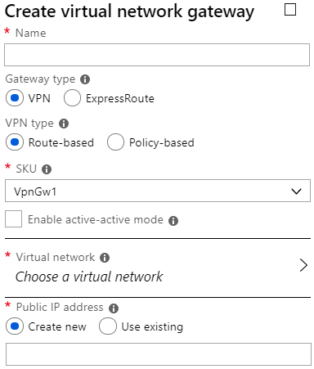
Create the VPN Gateway
Use the VPN Gateway type
Most VPN types are Route-based
Your choice of gateway SKU affects the number of tunnels you can have and the aggregate throughput benchmark
Associate a virtual network that includes the gateway subnet
The gateway needs a public IP address
✔️ It can take up to 45 minutes to provision the VPN gateway
Notes:
Gateway types and VPN types are covered in the next two topics.

Slide 57

VPN Types
Policy-based VPNs encrypt and direct packets through IPsec tunnels based on the IPsec policies
Can only be used on the Basic gateway SKU
You can have only 1 tunnel
You can only use Policy-based VPNs for S2S connections
Route-based VPNs use routes in the IP forwarding or routing table to direct packets
Most VPN Gateway configurations require a Route-based VPN

Slide 58
Gateway SKUs
SKU | S2S/VNet-to-VNet Tunnels | P2S SSTP Connections | P2S IKEv2 Connections | Aggregate Throughput Benchmark
Basic | Max. 10 | Max. 128 | Not Supported | 100 Mbps
VpnGw1 | Max. 30 | Max. 128 | Max. 250 | 650 Mbps
VpnGw2 | Max. 30 | Max. 128 | Max. 500 | 1 Gbps
VpnGw3 | Max. 30 | Max. 128 | Max. 1000 | 1.25 Gbps
✔️ The Basic SKU is considered a legacy SKU

Slide 59
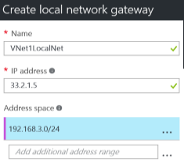
Create the Local Network Gateway
Refers to the on-premises location
Give the site a name by which Azure can refer to it
The local gateway needs a public IP address
Specify the IP address prefixes that will be routed through the gateway to the VPN device

Slide 60
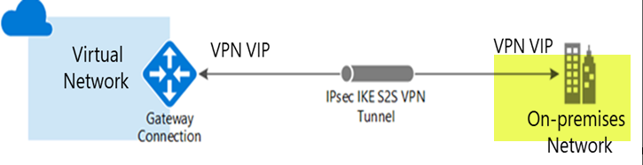
Configure the On-Premises VPN Device
Consult the list of supported VPN devices (Cisco, Juniper, Ubiquiti, Barracuda Networks)
A VPN device configuration script may be available
Remember the shared key for the Azure connection (next step)
Specify the public IP address (previous step)
Notes:
For more information, you can see:
Validated VPN devices list - https://docs.microsoft.com/en-us/azure/vpn-gateway/vpn-gateway-about-vpn-devices#devicetable

Slide 61
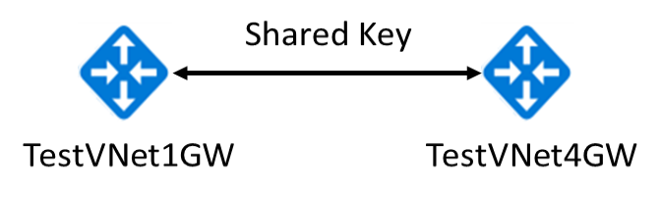
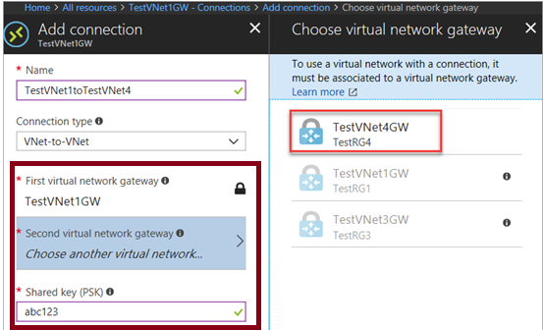
Create the VPN Connection
Once your VPN gateways are created, you can create the connection between them.
If your VNets are in the same subscription, you can use the portal.
The shared key provides the connection
Must create the connection for each virtual network
Notes:
✔️ If your VNets are in different subscriptions, you must use PowerShell to make the connection. You can use the New-AzVirtualNetworkGatewayConnection command. This command can also be used for Site-to-Site connections.

Slide 62
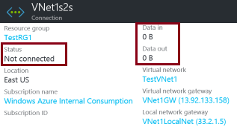
Verify the VPN Connection
Azure Portal - Status should be Succeeded or Connected. Data should be flowing in the Data in and Data out information section.
PowerShell
# Verify the connection
Get-AzVirtualNetworkGatewayConnection -Name MyGWConnection -ResourceGroupName MyRG
# Review the status
"connectionStatus": "Connected",
"ingressBytesTransferred": 33509044,
"egressBytesTransferred": 4142431
Notes:
For more information, you can see:
Verify the VPN connection - https://docs.microsoft.com/en-us/azure/vpn-gateway/vpn-gateway-howto-site-to-site-resource-manager-portal#VerifyConnection

Slide 63
Demonstration – VNet-to-VNet Connections
Explore the Gateway subnet blade
Explore the Connections blade
Explore adding a virtual network gateway
Explore adding a connection between the virtual networks

Slide 64
Lesson 03: ExpressRoute Connections

Slide 65
ExpressRoute Connections Overview
ExpressRoute
ExpressRoute Capabilities
ExpressRoute Connections
Coexisting Site-to-Site and ExpressRoute

Slide 66
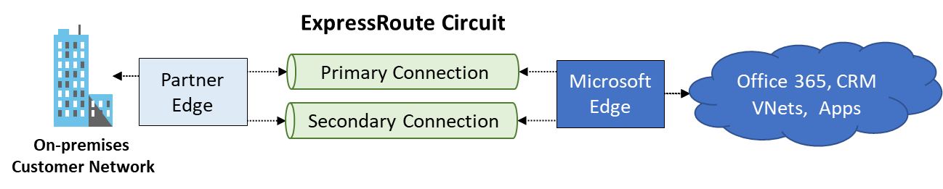
ExpressRoute
Extends on-premises networks into Microsoft cloud with dedicated private connections
Excellent for data migration, business continuity, and disaster recovery
Cost-effective option for transferring datasets
Adds high throughput and fast latency capacity to your datacenter
Notes:
For more information, you can see:
ExpressRoute - https://azure.microsoft.com/en-us/services/expressroute/

Slide 67
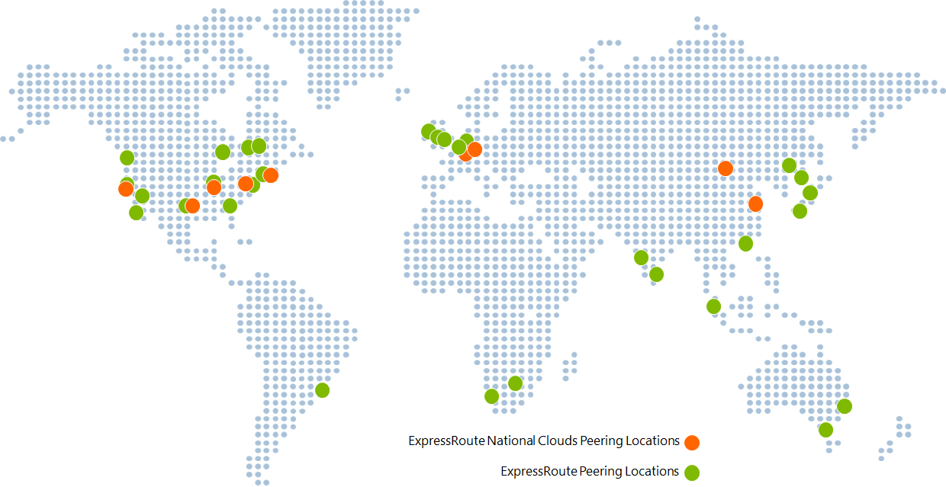
ExpressRoute Capabilities
Layer 3 connectivity with redundancy
Connectivity to all regions within a geography
Global connectivity with ExpressRoute premium add-on
Across on-premises connectivity with ExpressRoute Global Reach
Bandwidth options – 50 Mbps to 10 Gbps
Billing models – unlimited, metered, premium

Slide 68
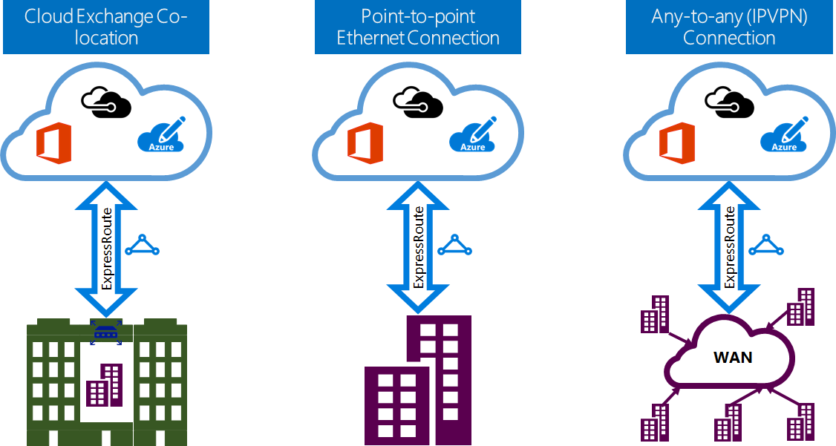
ExpressRoute Connections
Notes:
✔ ExpressRoute capabilities and features are all identical across all the above connectivity models.

Slide 69
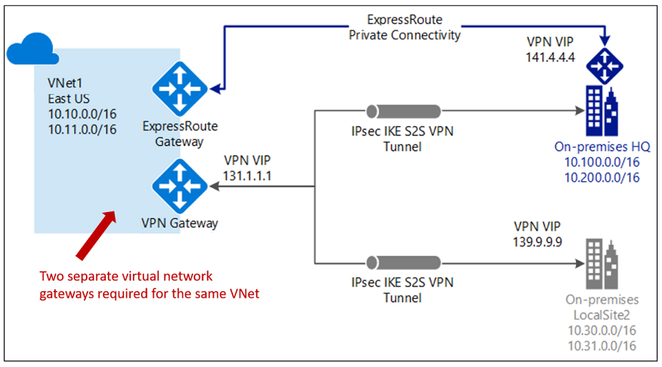
Coexisting Site-to-Site and ExpressRoute
Use S2S VPN as a secure failover path for ExpressRoute
Use S2S VPNs to connect to sites that already connected with ExpressRoute
Notice two VNet gateways for the same virtual network'
Notes:
✔ Currently, the deployment options for S2S and ExpressRoute coexisting connections are only possible through PowerShell, and not the Azure portal.

Slide 70
Lesson 04: Lab and Review Questions

Slide 71
Lab – VNet Peering and Service Chaining
Adatum Corporation wants to implement service chaining between Azure virtual networks in its Azure subscription
Exercise 0: Prepare the environment
Exercise 1: Configure VNet Peering
Exercise 2: Implement custom routing
Exercise 3: Validate service chaining
Lab timing: 60 minutes

Slide 72
Module Review Questions
Notes:
As you have time go through the Module Review questions in the student materials.

Slide 73
AZ-103T00A Module 08: Network Traffic Management
Notes:
The Load Balancer and Traffic Manager lab for this module has setup time. If you are going to do the lab, consider completing Exercise 0: Prepare the lab environment before starting the lecture.

Slide 74
Module Overview
Network Routing
Azure Load Balancer
Azure Traffic Manager
Lab and Review Questions
Notes:
Module overview

Slide 75
Lesson 01: Network Routing

Slide 76
Network Routing Overview
System Routes
User Defined Routes
Routing Examples
Create a Routing Table
Create a Custom Route
Associate the Route

Slide 77
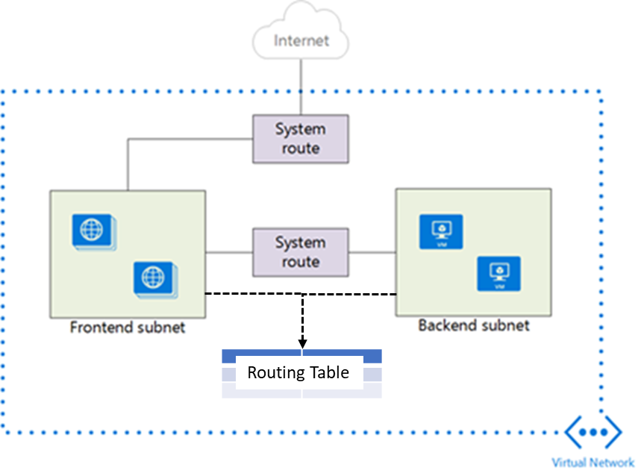
System Routes
System routes direct network traffic between virtual machines, on-premises networks, and the Internet
Traffic between VMs in the same subnet
Between VMs in different subnets in the same virtual network
Data flow from VMs to the Internet
Communication between VMs using a VNet-to-VNet VPN
Site-to-Site and ExpressRoute communication through the VPN gateway
Notes:
For more information, you can see:
System routes - https://docs.microsoft.com/en-us/azure/virtual-network/virtual-networks-udr-overview#system-routes

Slide 78
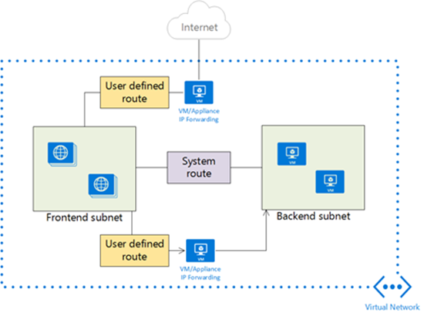
User Defined Routes
A route table contains a set of rules, called routes, that specifies how packets should be routed in a virtual network
User-defined routes are custom routes that control network traffic by defining routes that specify the next hop of the traffic flow
The next hop can be a virtual network gateway, virtual network, internet, or virtual appliance
Notes:
✔ Each route table can be associated to multiple subnets, but a subnet can only be associated to a single route table. There are no additional charges for creating route tables in Microsoft Azure. Do you think you will need to create custom routes?

Slide 79
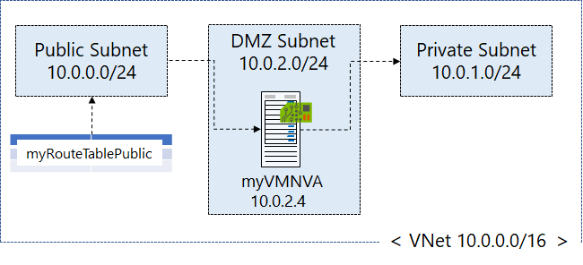
Routing Example
Create a routing table
Create a custom route
Associate the route to the subnet
Notes:
The next three topics will cover this information.

Slide 80
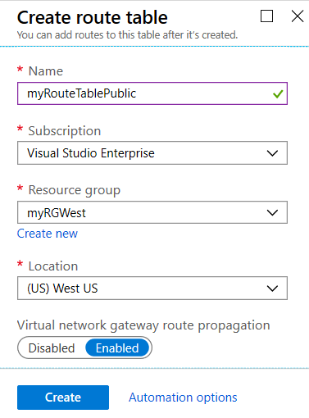
Create a Routing Table
A standard routing protocol is used to exchange routing and reachability information between two or more networks
Routes are automatically added to the route table of all subnets with virtual network gateway route propagation enabled
In most situations you will want to enable route propagation
Notes:
Overview of BGP with Azure VPN Gateways - https://docs.microsoft.com/en-us/azure/vpn-gateway/vpn-gateway-bgp-overview?toc=%2fazure%2fvirtual-network%2ftoc.json

Slide 81
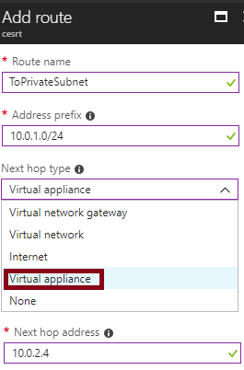
Create a Custom Route
When you create a route there are several Next hop types
In this example, any private subnet IP addresses will be sent to the virtual appliance
Other choices are Virtual network gateway, Virtual network, Internet, and None

Slide 82
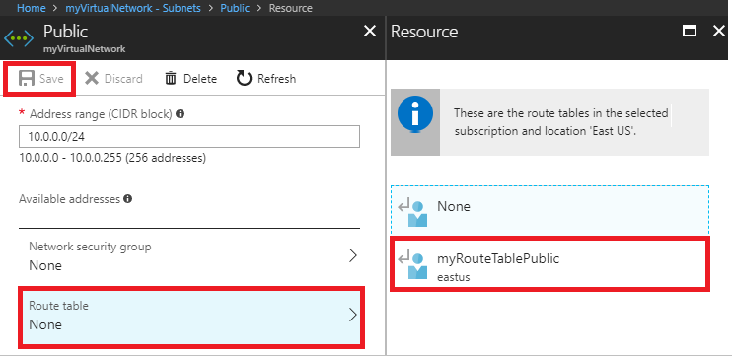
Associate the Route
Each subnet can have zero or one route table associated to it
In our example, the Public subnet will be associated with the routing table
Notes:
✔️ In this case the virtual appliance should not have a public IP address and IP forwarding should be enabled.

Slide 83
Demonstration – Custom Routing Tables
Create a route table
Add a route
Associate a route table to a subnet
Use PowerShell to view your routing information

Slide 84
Lesson 02: Azure Load Balancer

Slide 85
Azure Load Balancer Overview
Azure Load Balancer
Public Load Balancer
Internal Load Balancer
Load Balancer SKUs
Backend Pools
Load Balancer Rules
Session Persistence
Health Probes
Notes:
Lesson overview

Slide 86
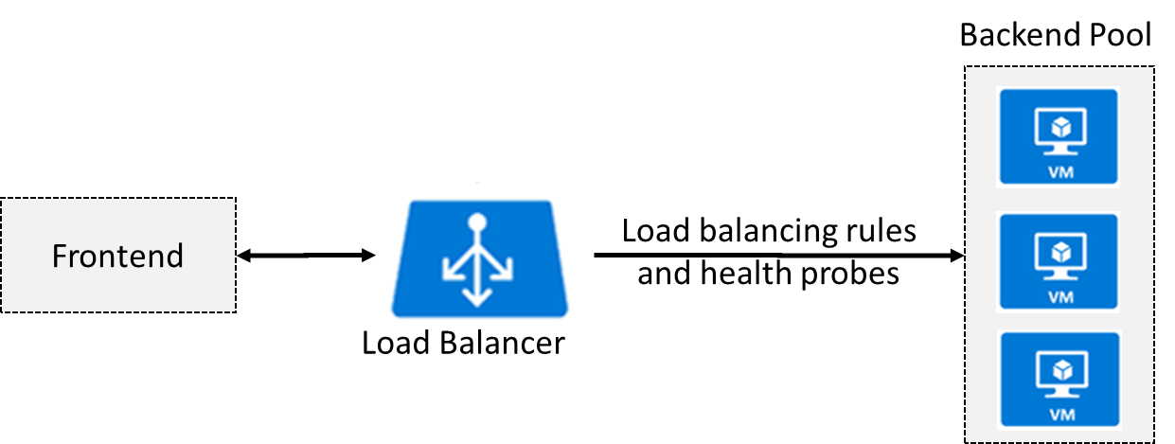
Azure Load Balancer
Distributes inbound traffic to backend resources using load-balancing rules and health probes
Can be used for both inbound/outbound scenarios
Protect on-premises web applications with secure remote access
Extend Active Directory to the cloud
Two types: Public and Internal
Notes:
✔ Keep this diagram in mind since it covers the four components that must be configured for your load balancer: Frontend IP configuration, Backend pools, Health probes, and Load balancing rules.
For more information, you can see:
Load Balancer documentation - https://docs.microsoft.com/en-us/azure/load-balancer/

Slide 87
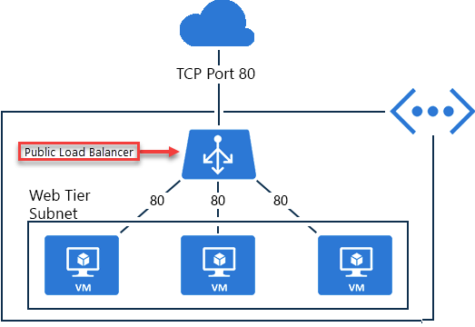
Public Load Balancer
Maps public IP addresses and port number of incoming traffic to the VM’s private IP address and port number, and vice versa.
Apply load balancing rules to distribute traffic across VMs or services.

Slide 88
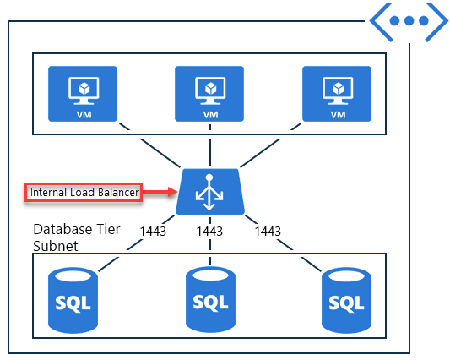
Internal Load Balancer
Directs traffic only to resources inside a virtual network or that use a VPN to access Azure infrastructure.
Frontend IP addresses and virtual networks are never directly exposed to an internet endpoint.
Enables load balancing within a virtual network, for cross-premises virtual networks, for multi-tier applications, and for line-of-business applications.
Notes:
✔ Can you see how a public load balancer could be placed in front of the internal load balancer to create a multi-tier application.

Slide 89
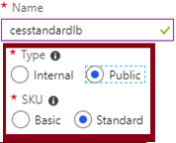
Load Balancer SKUs
Load balancer supports both Basic and Standard (newer) SKUs
SKUs are not mutable
Load Balancer rule cannot span two virtual networks
No charge for the Basic load balancer
Load Balancer frontends are not accessible across global virtual network peering

Slide 90
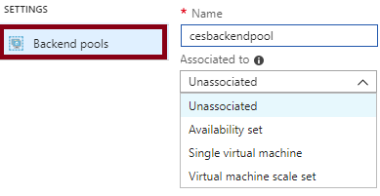
Backend Pools
SKU | Backend pool endpoints
Basic SKU | VMs in a single availability set or VM scale set.
Standard SKU | Any VM in a single virtual network, including a blend of VMs, availability sets, and VM scale sets.
To distribute traffic, a back-end address pool contains the IP addresses of the virtual NICs that are connected to the load balancer.
Notes:
✔ In the Standard SKU you can have up to 1000 instances in the backend pool. In the Basic SKU you can have up to 100 instances.

Slide 91
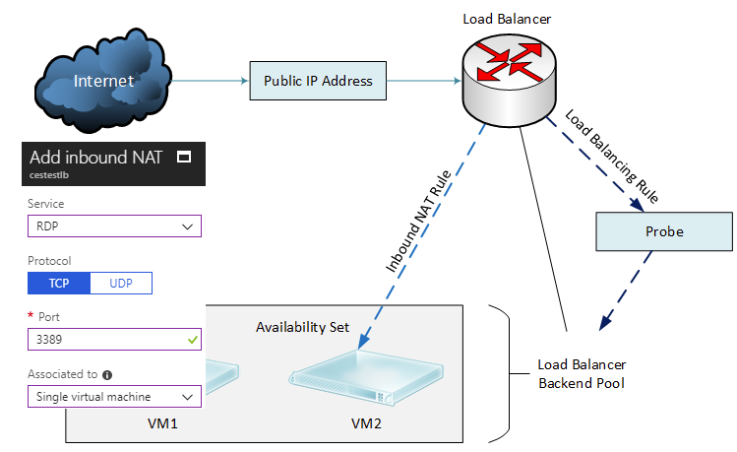
Load Balancer Rules
Maps a frontend IP and port combination to a set of backend IP addresses and port combination
Rules can be used in combination with NAT rules
A NAT rule is explicitly attached to a VM (or network interface) to complete the path to the target
Notes:
✔ Can you see the difference between load balancing rules and NAT rules? Remember, this approach should only be used when you need connectivity from the Internet. Most normal communications would occur from on-premises to Azure connections such as site-to-site VPN and ExpressRoute.

Slide 92
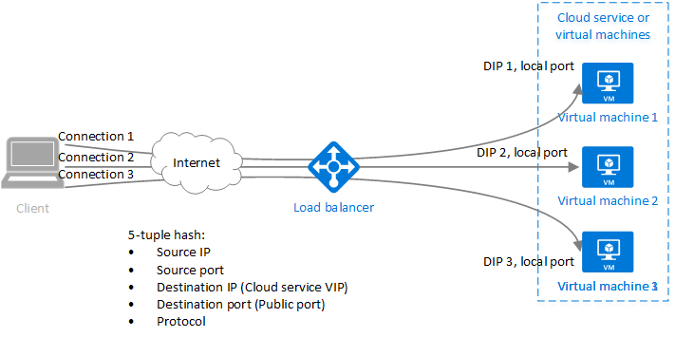
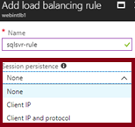
Session Persistence
Session persistence specifies how client traffic is handled
Client IP (default) requests can be handled by any virtual machine
Client IP and protocol specifies that successive requests from the same address and protocol will be handled by the same virtual machine
Notes:
✔Keeping session persistence information is very important in applications that use a shopping cart. Can you think of any other applications?

Slide 93
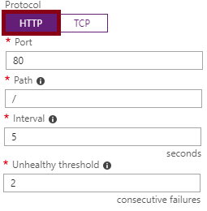
Health Probes
Allows the load balancer to monitor the status of an app
Dynamically adds or removes VMs from the load balancer rotation based on their response to health checks
HTTP custom probe (preferred) pings every 15 seconds
TCP custom probe tries to establish a successful TCP session
Notes:
✔ There is also a guest agent probe. This probe uses the guest agent inside the VM. It is not recommended when HTTP or TCP custom probe configurations are possible. Relate back to the original diagram to ensure all the components are covered.

Slide 94
Lesson 03: Azure Traffic Manager

Slide 95
Azure Traffic Manager Overview
Azure Traffic Manager
Traffic Manager Features
Priority Routing
Performance Routing
Geographic Routing
Weighted Routing
Implementing Traffic Manager Profiles
Implementing Traffic Manager Endpoints
Traffic Manager vs Load Balancer
Notes:
Lesson overview

Slide 96

Azure Traffic Manager
Allows you to control distribution of user traffic to service endpoints around the world
Uses DNS to direct end-user requests to the most appropriate endpoint
Selects an endpoint based on the configuring traffic-routing method
Provides endpoint health checks and automatic endpoint failover
Notes:
For more information, you can see:
Traffic Manager - https://azure.microsoft.com/en-us/services/traffic-manager/

Slide 97
Traffic Manager Features
Improve availability of critical applications
Improve responsiveness for high performance applications
Upgrade and perform service maintenance without downtime
Combine on-premises and Cloud-based applications
Distribute traffic for large, complex deployments
Create profiles for different routing scenarios
Several routing algorithms (next topics)

Slide 98

Priority Routing
Routes traffic to a prioritized list of service endpoints
Sends all traffic to the primary (highest-priority) endpoint first

Slide 99

Performance Routing
Routes traffic to the location closest to the user
The closest endpoint is measured by network latency recorded in a table
Notes:
✔ Remember Traffic Manager does not receive DNS queries directly from clients. Rather, DNS queries come from the recursive DNS service that the clients are configured to use. Therefore, the IP address used to determine the 'closest' endpoint is not the client's IP address, but it is the IP address of the recursive DNS service. In practice, this IP address is a good proxy for the client.

Slide 100

Geographic Routing
Routes traffic to a set of geographic locations
A location cannot be in more than one endpoint
Regional Grouping
Country/Region
State/Province
Notes:
✔ Similar to Performance routing Traffic Manager uses the source IP address of the DNS query to determine the region from which a user is querying from. Usually, this is the IP address of the local DNS resolver doing the query on behalf of the user.

Slide 101

Weighted Routing
Distributes traffic evenly using a pre-defined weighting
Higher weight equals higher priority
Notes:
✔ Using the same weight across all endpoints results in an even traffic distribution. Using higher or lower weights on specific endpoints causes those endpoints to be returned frequently in the DNS responses.

Slide 102

Implementing Traffic Manager Profiles
Select the routing method in the Traffic Manager profile
The DNS TTL determines how often to query for updated DNS entries
Configure each endpoint with the same monitoring settings
You can Enable or Disable your profile at anytime

Slide 103

Implementing Traffic Manager Endpoints
Azure endpoints - Use this type of endpoint to load balance traffic to a Cloud service, Web app, or Public IP address in the same subscription
External endpoints - Use this type of endpoint to load balance traffic to any fully-qualified domain name, even for applications not hosted in Azure

Slide 104
Distributing Network Traffic
Service | Azure Load Balancer | Traffic Manager
Technology | Transport layer (level 4) | DNS
Protocols | Any | Any HTTP/S endpoint needed for endpoint monitoring
Endpoints | Azure VMs and Cloud Services role instances | Azure VMs, Cloud Services, Azure Web Apps, and external endpoints
Network connectivity | Both internet-facing and internal (VNet) applications | Internet-facing
Azure has several options to distribute network traffic
They can each be used in isolation or in combination

Slide 105
Lesson 04: Lab and Review Questions

Slide 106
Lab – Load Balancer and Traffic Manager
Adatum Corporation wants to implement Azure VM-hosted web workloads by leveraging load balancing and Network Address Translation (NAT) features of Azure Load Balancer.
Exercise 0: Deploy Azure VMs by using Azure Resource Manager templates
Exercise 1: Implement Azure Load Balancing
Exercise 2: Implement Azure Traffic Manager load balancing
Lab time: 60 minutes

Slide 107
Module Review Questions
Notes:
As you have time go through the Module Review questions in the student materials.

Slide 108
AZ-103T00A Module 12: Data Services
Notes:
The Implement File Sync lab for this module has setup time. If you are going to do the lab, consider completing Exercise 0: Prepare the lab environment before starting the lecture.

Slide 109
Module Overview
Content Delivery Network
File Sync
Import and Export Service
Data Box
Lab and Review Questions
Notes:
Module overview

Slide 110
Lesson 01: Content Delivery Network

Slide 111
Content Delivery Network Overview
CDN Benefits
How CDN Works
CDN Profiles
CDN Endpoints
CDN Time-to-Live
CDN Compression
Notes:
Lesson overview

Slide 112

Content Delivery Network Benefits
CDN is a distributed network of servers that can efficiently deliver content (usually static content) to users
CDNs cache content on edge servers that are close to end-users
Lower latency and faster delivery of content
Reduced load on the server or application
Notes:
✔️ CDN provides a faster, more responsive user experience. Do you think your organization would be interested in this feature?
✔️ Use the following link to review some of the challenges with deploying CDN including security, deployment, versioning, and testing.
For more information, you can see:
Content Delivery Network Documentation - https://docs.microsoft.com/en-us/azure/cdn/cdn-overview

Slide 113

How CDN Works
User requests a file
Edge server requests file from origin
Origin returns the file to the edge server
Edge server caches the file and returns the file to the original requestor
Additional user requests the same file
Edge server returns the file from the cache
Notes:
✔️ After you enable CDN access to a storage account, all publicly available objects are eligible for CDN edge caching. If you modify an object that's currently cached in the CDN, the updated content will not be available via CDN until CDN refreshes its content after the time-to-live period for the cached content expires.

Slide 114

CDN Profiles
A CDN profile is a collection of CDN endpoints with the same pricing tier and provider (origin)
Can create multiple profiles to organize endpoints
Up to eight profiles per subscription
Different pricing tiers
Notes:
✔️ Can you think of different scenarios that would require different CDN profiles?

Slide 115

CDN Endpoints
Origin types: Storage, Cloud Service, Web App, and Custom origin
The CDN endpoint for this storage example: ASHStorage.azureedge.net/…
Add custom domain mapping to your CDN endpoint and enable custom domain HTTPS
Additional CDN features for your delivery, such as compression, query string, and geo filtering
Notes:
✔️ Because it takes time for the registration to propagate, the endpoint isn't immediately available for use. For Azure CDN from Akamai profiles, propagation usually completes within one minute. For Azure CDN from Verizon profiles, propagation usually completes within 90 minutes, but in some cases can take longer. Be sure to review the Troubleshooting pages reference link.

Slide 116


CDN Time-to-Live
Global caching rules set the Cache Expiration Duration for each endpoint in your profile.
Custom caching rules match specific paths and file extensions, are processed in order, and override the global caching rule.

Slide 117

CDN Compression
Improve file transfer speed and increase page-load performance
Reduce bandwidth costs and provide a more responsive experience
Enable compression on the origin server or on the CDN edge servers
Specify which MIME formats are compressed
Notes:
✔️Although it is possible, it is not recommended to apply compression to compressed formats. For example, ZIP, MP3, MP4, or JPG.

